Slide 1




COVID – 19 Interactive Visualizer with Chatbot
The deadly virus has directly affected 20 million people on the planet

Slide 2




Current Scenario
Too much info
Stressful
Time Consuming
More than 2500 websites worldwide
Information is dense
Confusion and mass hysteria
Difficulty accessing specific information
Inconvenient for non tech-savvy users

Slide 3


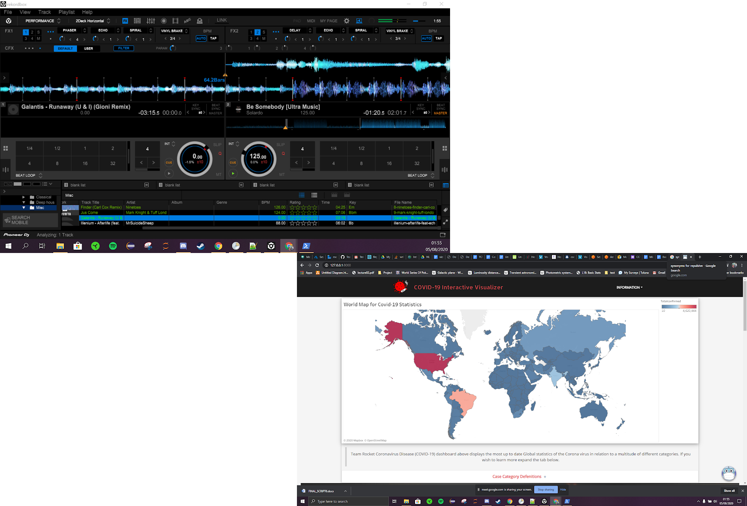

What We Offer
Chatbot
Interactive Visualization
Platform to answer specific user queries
User friendly
Provides up to date COVID-19 stats
Extensive information

Slide 4
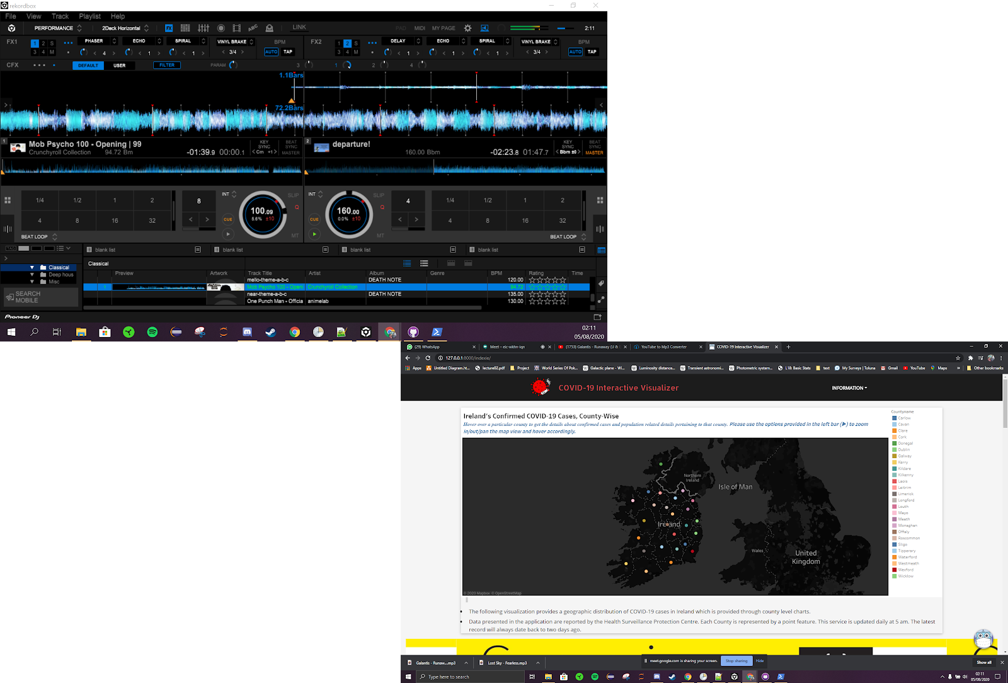
What We Offer
Chatbot
Interactive Visualization
Platform to answer specific user queries
User friendly
Provides up to date COVID-19 stats
Extensive information

Slide 5
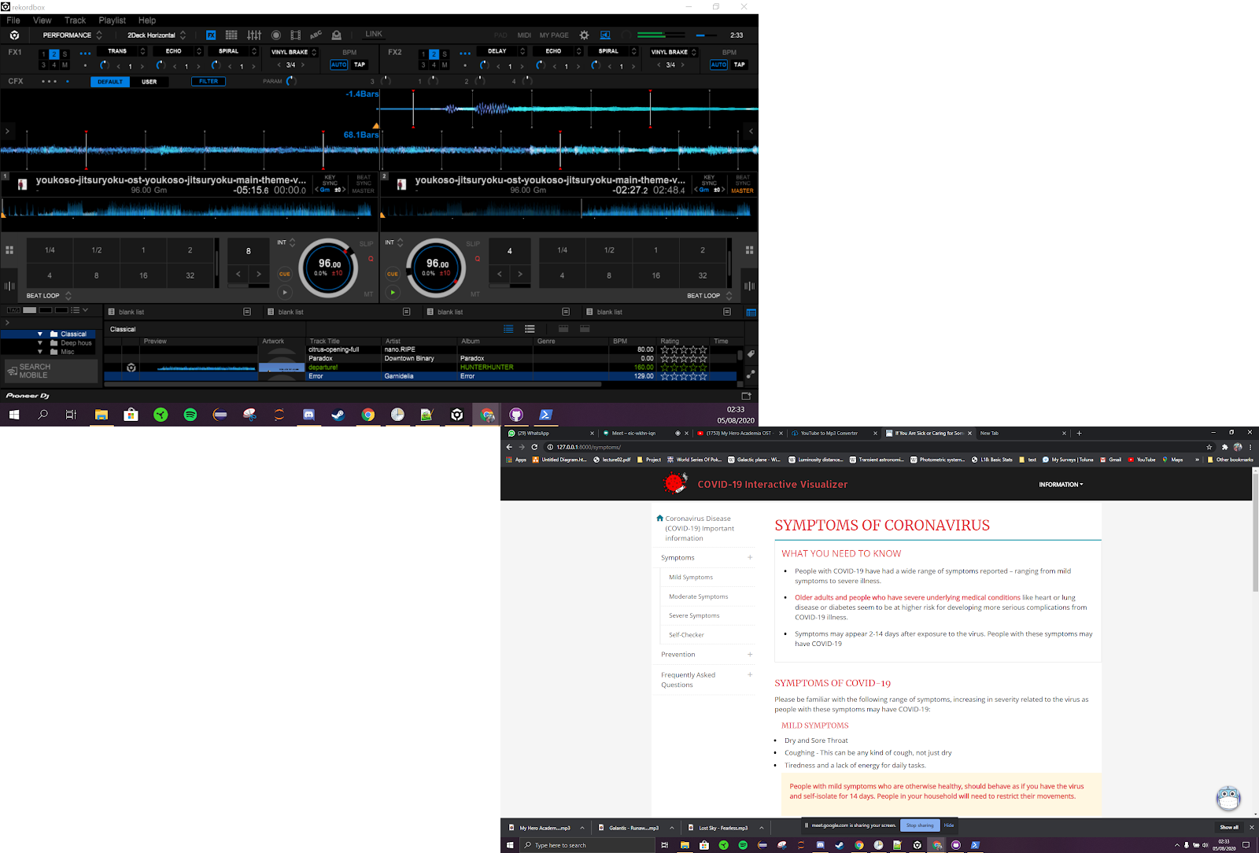
What We Offer
Chatbot
Interactive Visualization
Platform to answer specific user queries
User friendly
Provides up to date COVID-19 stats
Extensive information

Slide 6
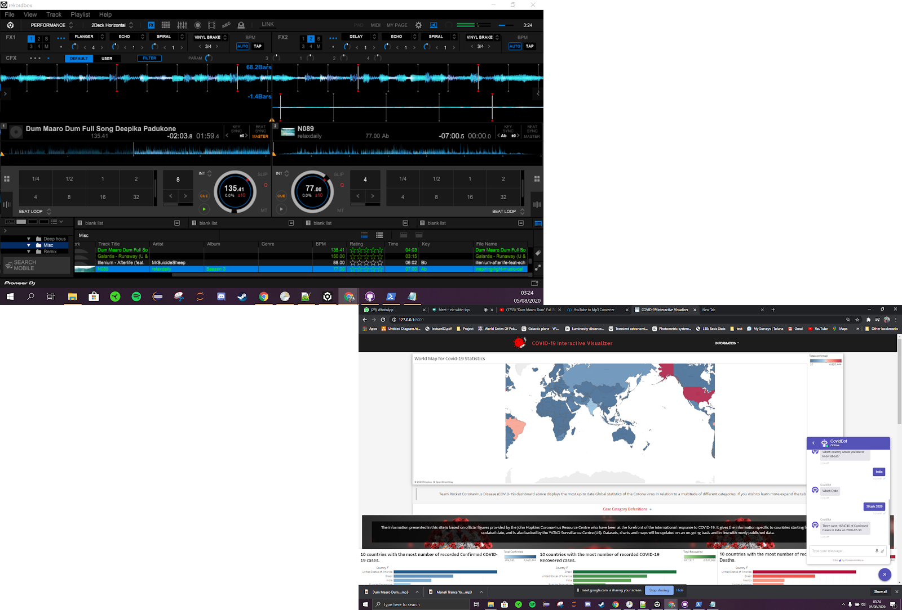
What We Offer
Chatbot
Interactive Visualization
Platform to answer specific user queries
User friendly
Provides up to date COVID-19 stats
Extensive information

Slide 7
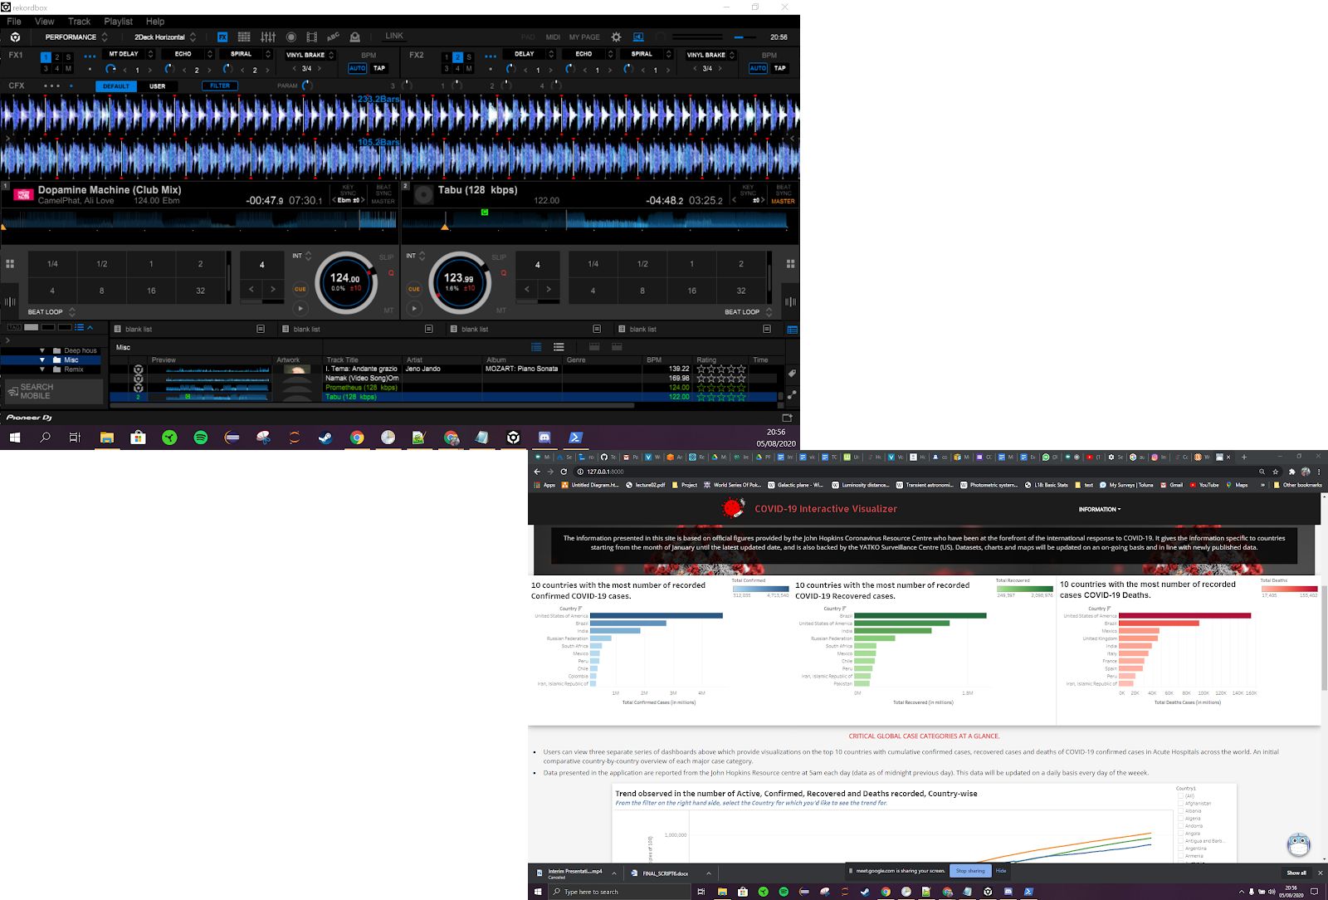
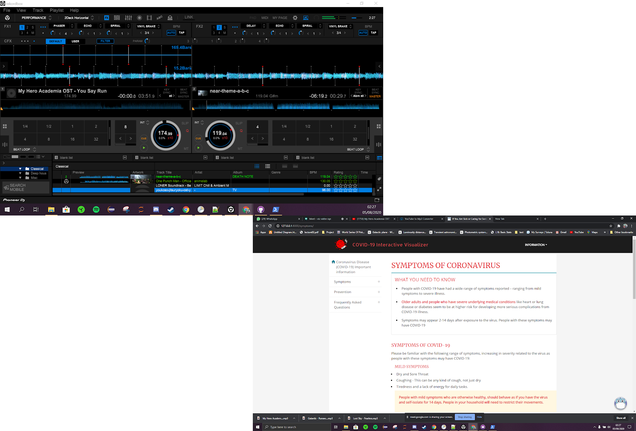
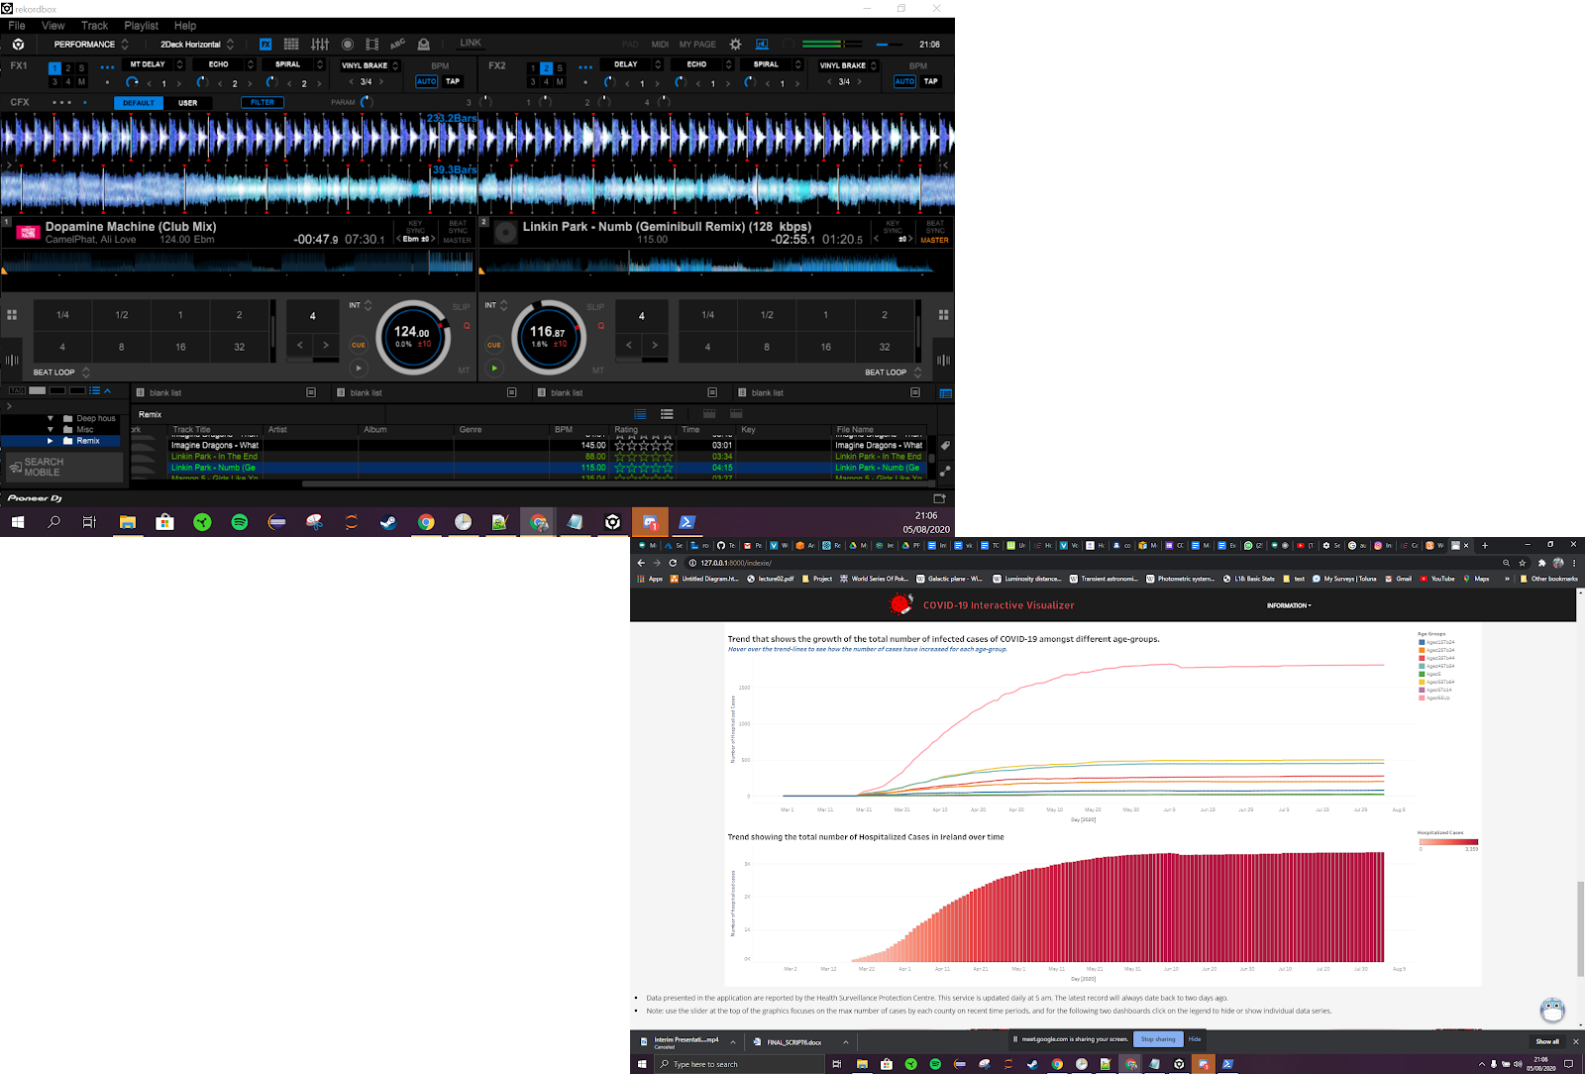
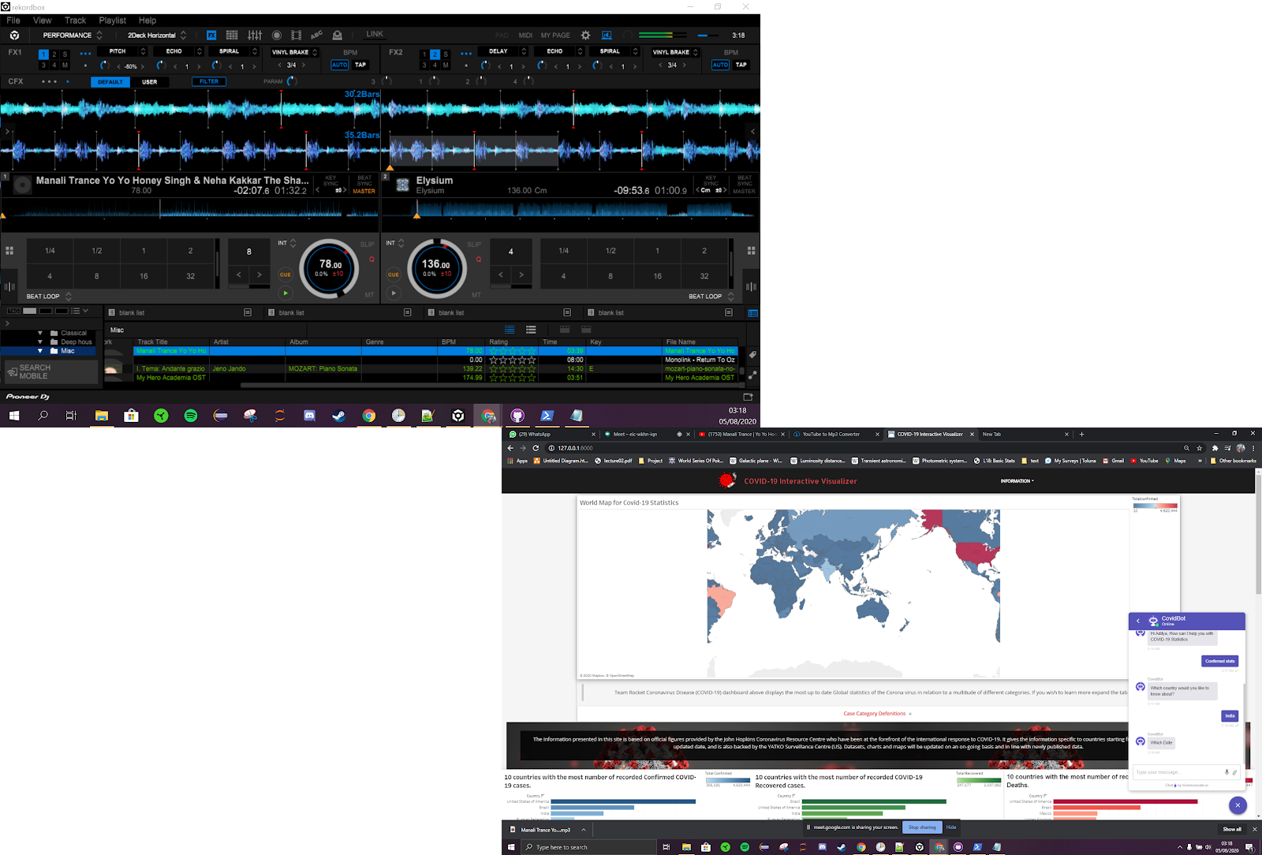
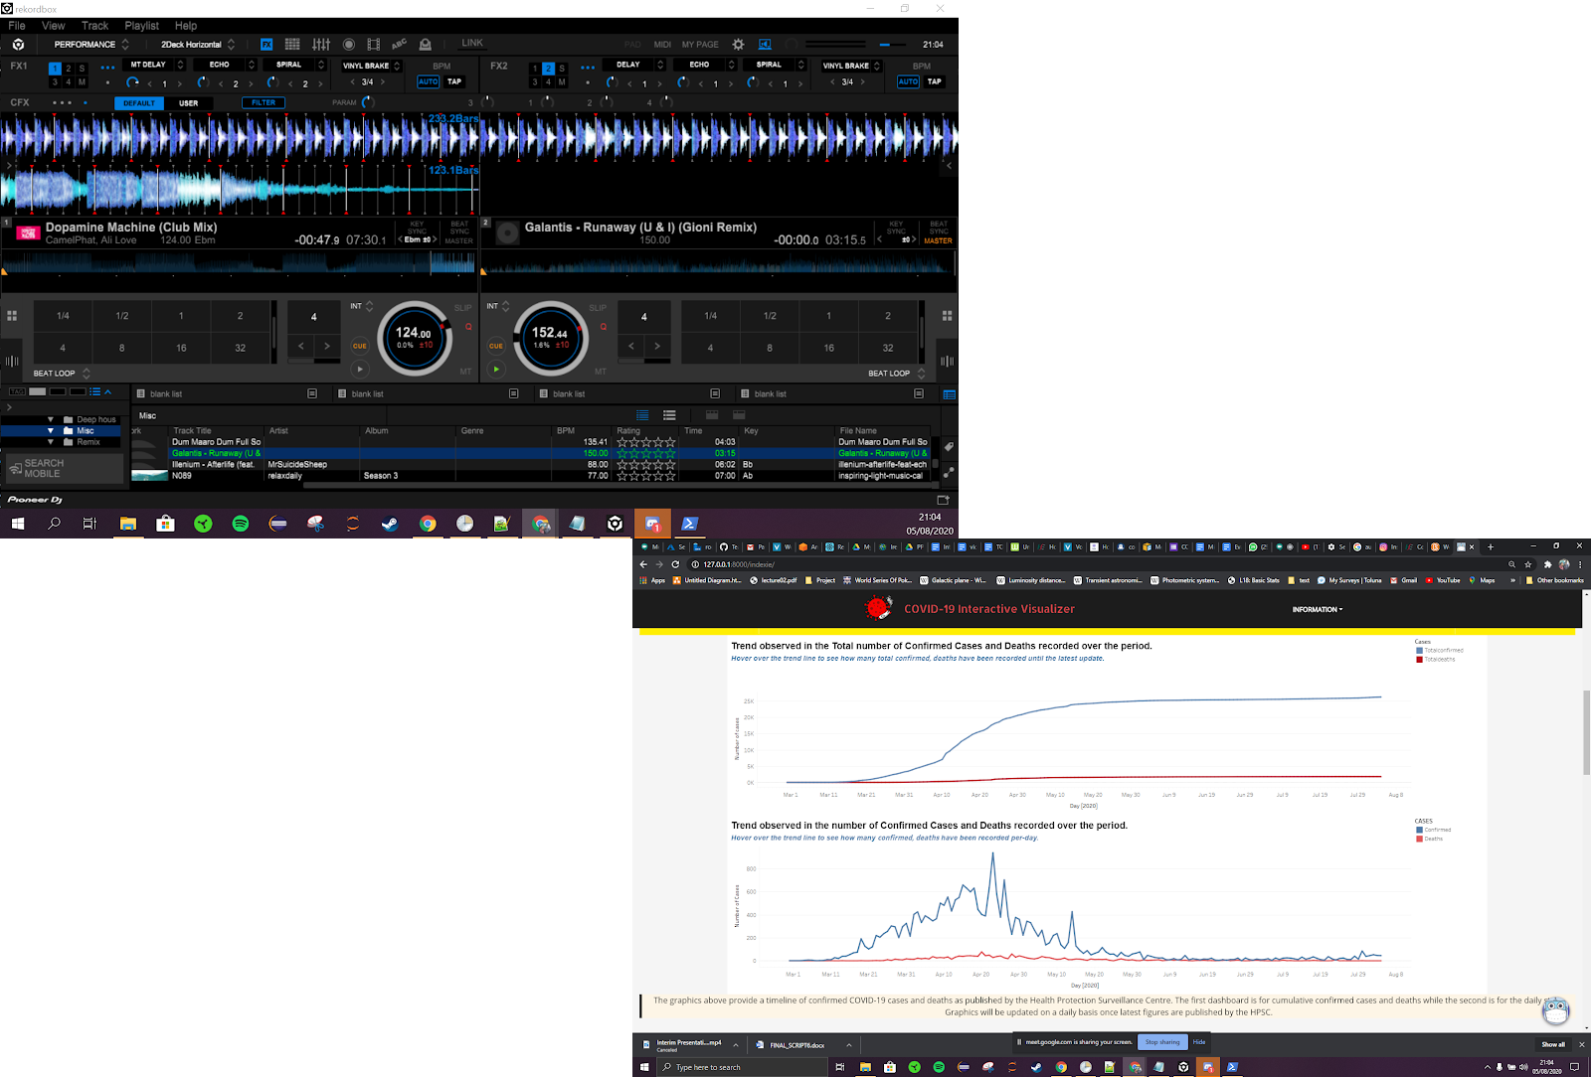
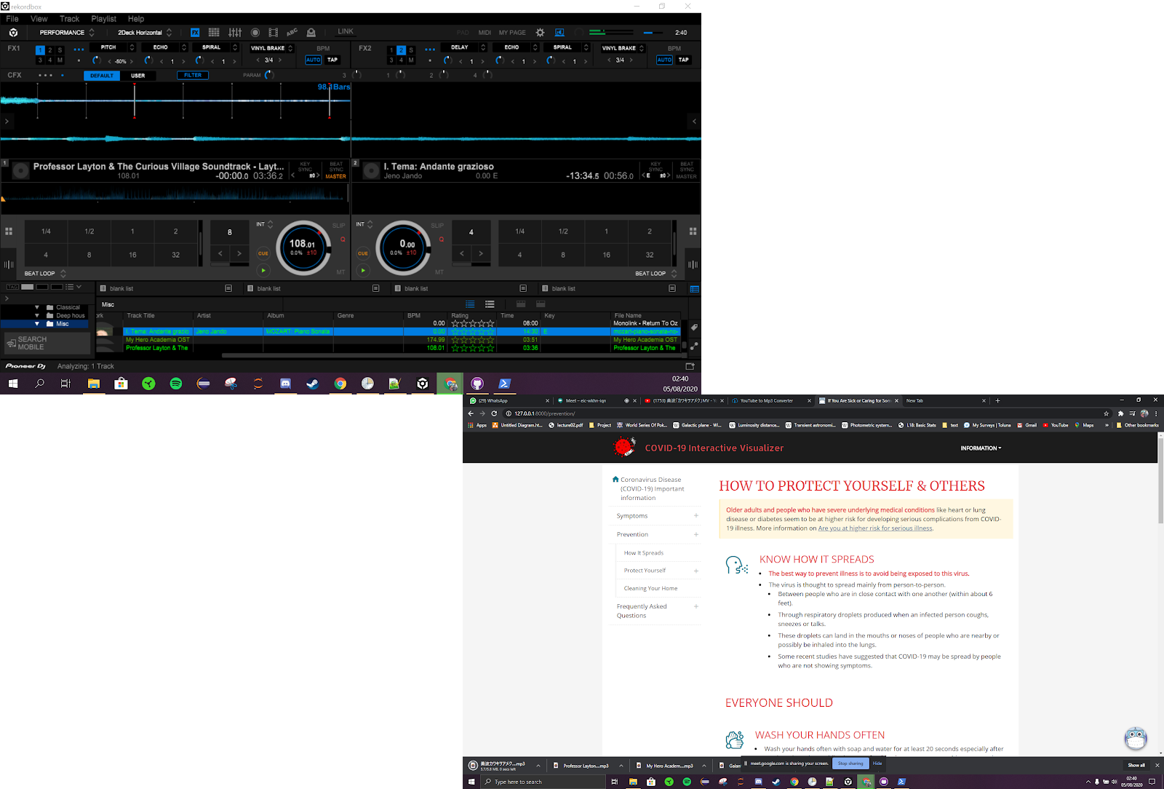
Who are we targeting
User Scenario 1
User Scenario 2
User Scenario 3
User Scenario 4
Global visualization
Ireland specific
General Queries
Chatbot

Slide 8




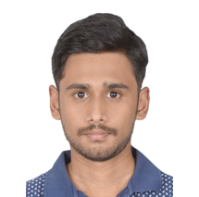



The Team
Data
Chatbot
Cloud
Web Dev
Apurva Deore
Vishal Padma
Sumit Kumar
Nripendra Singh
Ashwin Manikandan
Minaz Shaikh
Aditya Krishnan
Data Collection and analysis
Scripts for Data processing
Deployment of Lex API
Intents for user query responses
Setting up storage and DB servers
Pipelines and triggers for E2E automation
UI design and layout
Integration of front-end and back-end

Slide 9
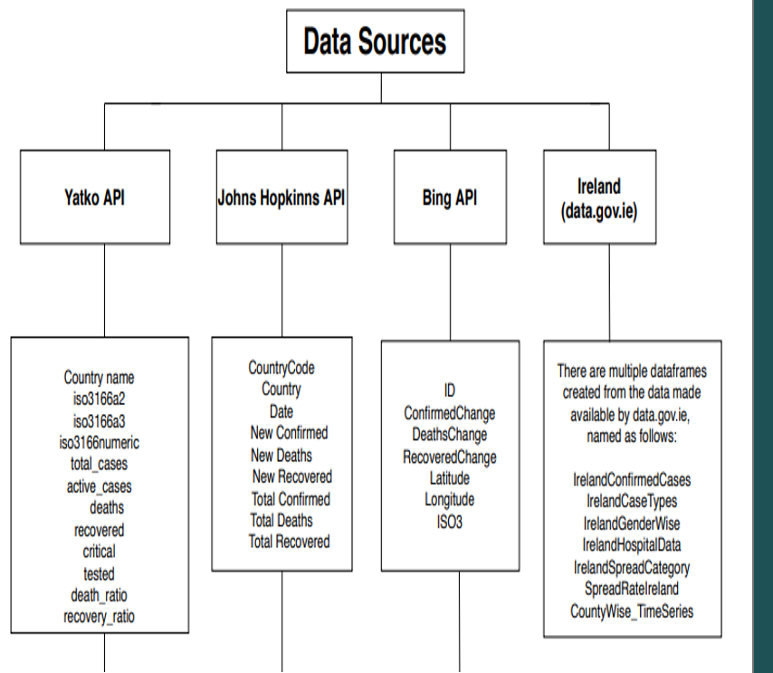
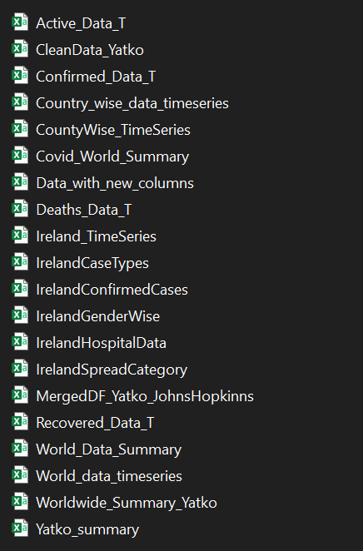
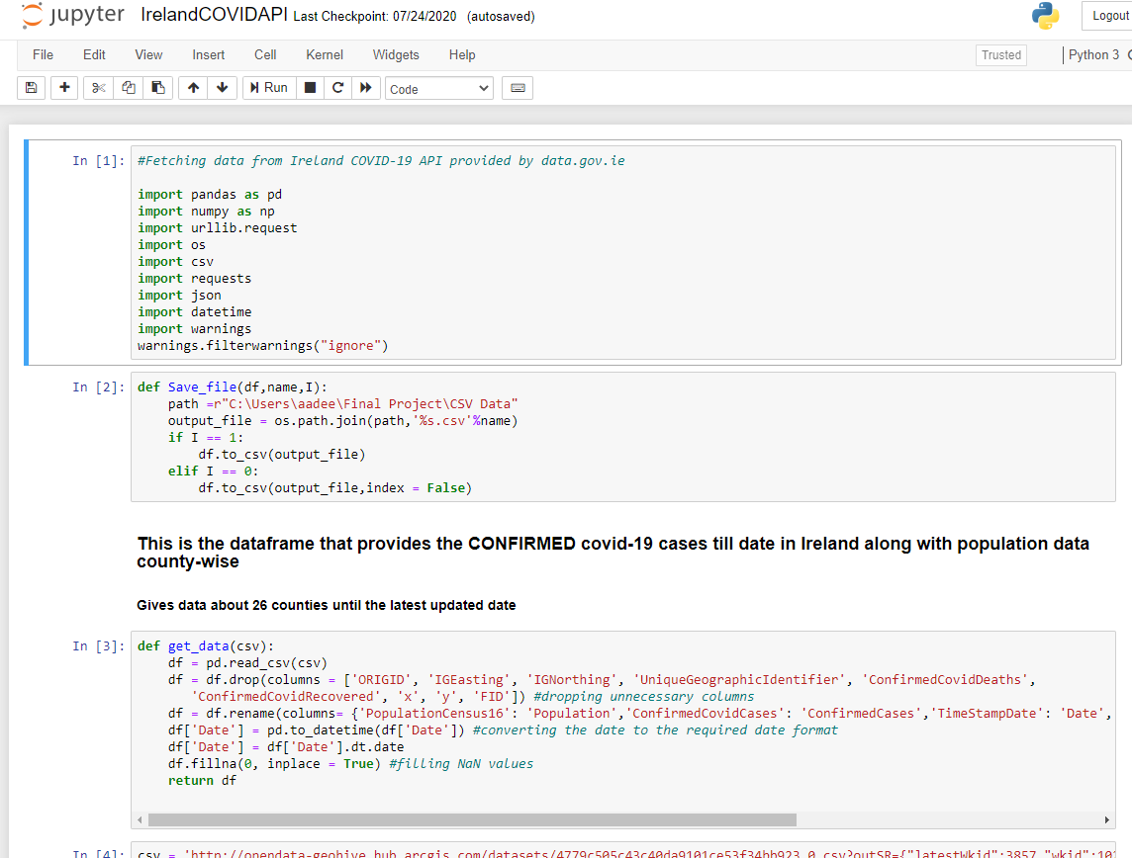
Data
Data Collection
Data cleaning and processing
Automation
Extracting data from different sources and Web APIs
Data from different sources cleaned and normalized
Scripts are automatically triggered using CRON jobs
The date formats were made same for all data received from the different sources
The data was converted in a different format before we can use it to convert it in the final form. Unnecessary columns were dropped, and gaps were filled by integrating the data from different sources
Data was converted in the times series format so that it can be used by Amazon Lex to answer queries
Formatting of data was also done for proper visualization

Slide 10
The Team
Data
Chatbot
Cloud
Web Dev
Apurva Deore
Vishal Padma
Sumit Kumar
Nripendra Singh
Ashwin Manikandan
Minaz Shaikh
Aditya Krishnan
Data Collection and analysis
Scripts for Data processing
Deployment of Lex API
Intents for user query responses
Setting up storage and DB servers
Pipelines and triggers for E2E automation
UI design and layout
Integration of front-end and back-end

Slide 11
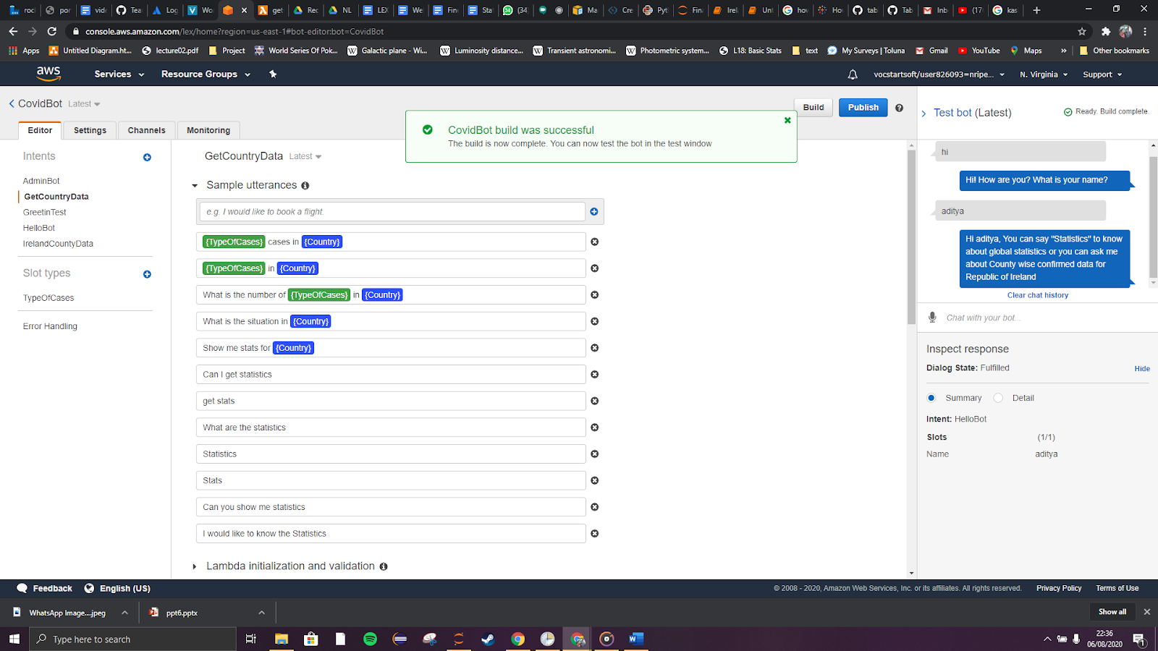
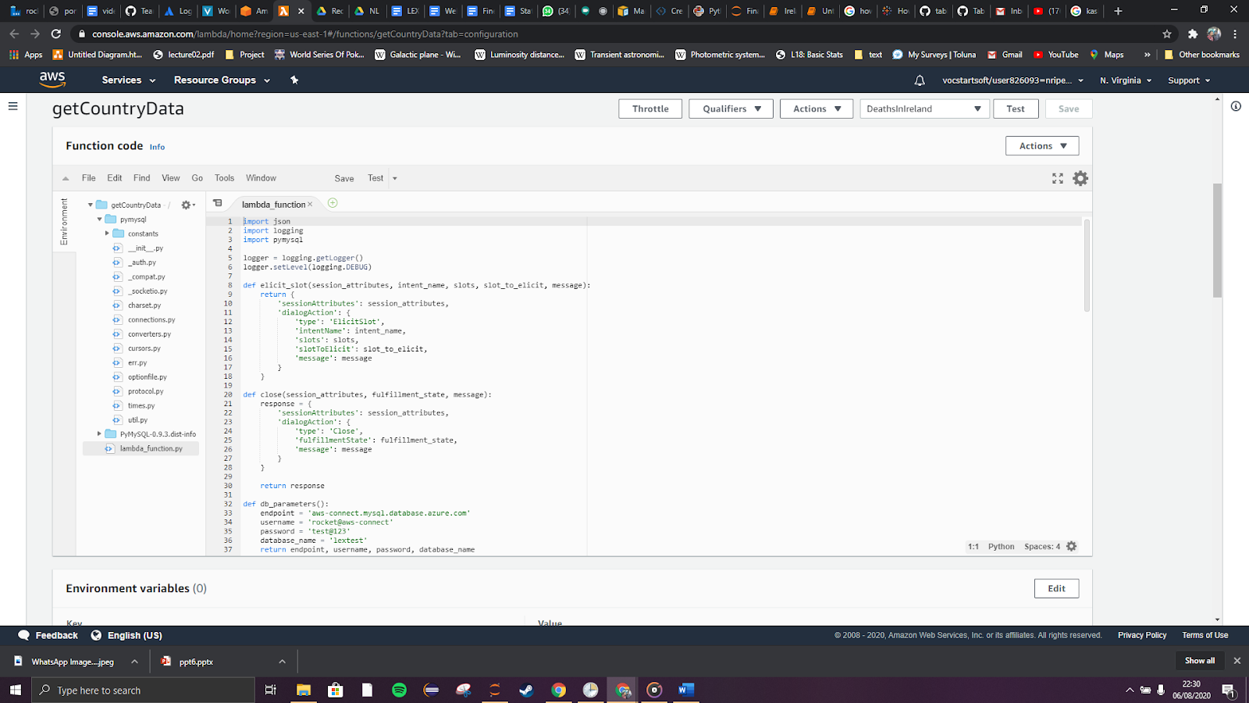
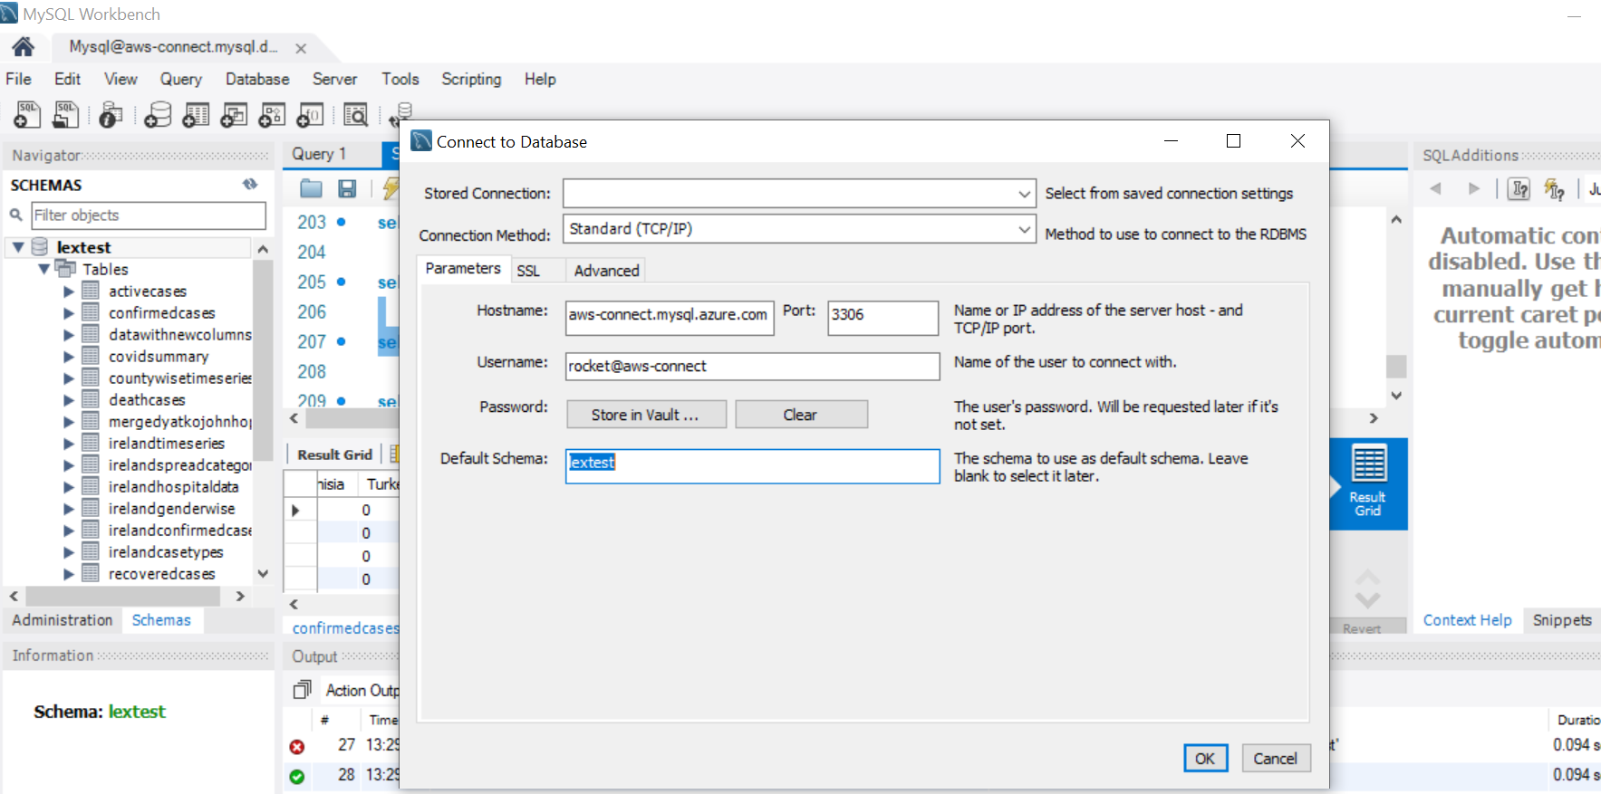
Chatbot
Getting started with Lex
Creating user intents
Training
Literature survey and deploying the initial version of chatbot
Crate user intents and connect to the MySQL database
Create lambda functions to train the chatbot

Slide 12
The Team
Data
Chatbot
Cloud
Web Dev
Apurva Deore
Vishal Padma
Sumit Kumar
Nripendra Singh
Ashwin Manikandan
Minaz Shaikh
Aditya Krishnan
Data Collection and analysis
Scripts for Data processing
Deployment of Lex API
Intents for user query responses
Setting up storage and DB servers
Pipelines and triggers for E2E automation
UI design and layout
Integration of front-end and back-end

Slide 13
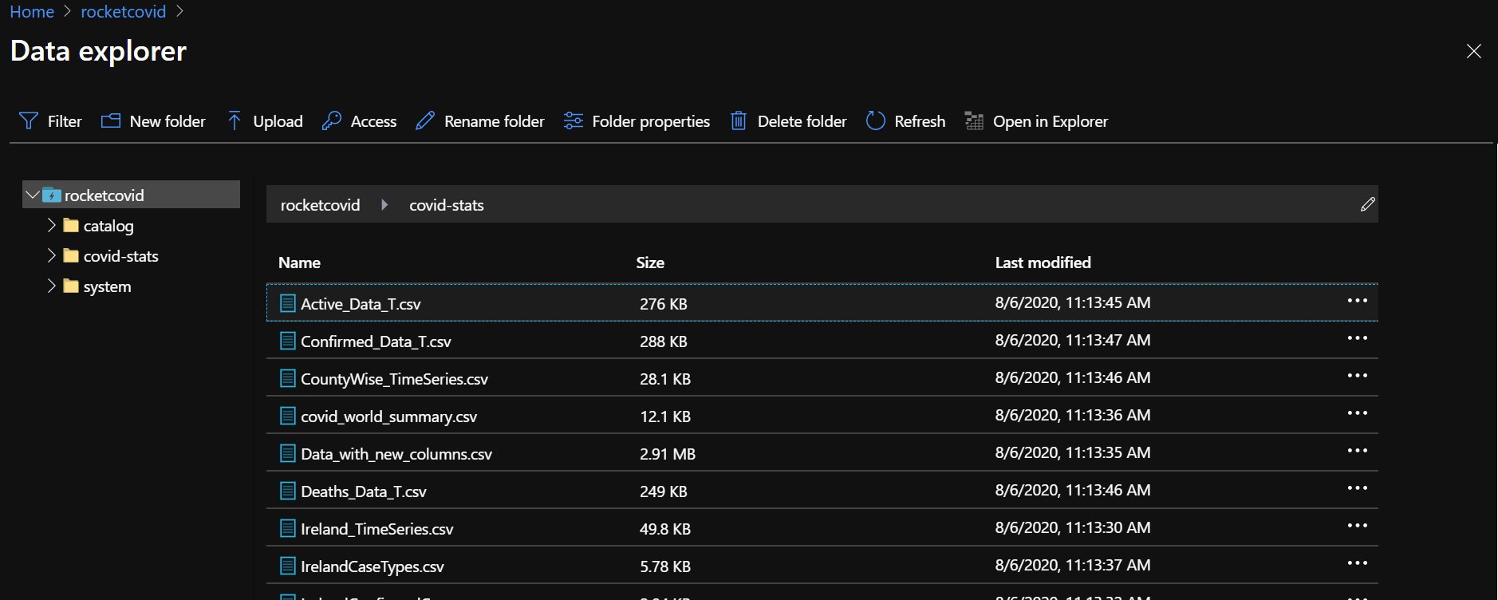
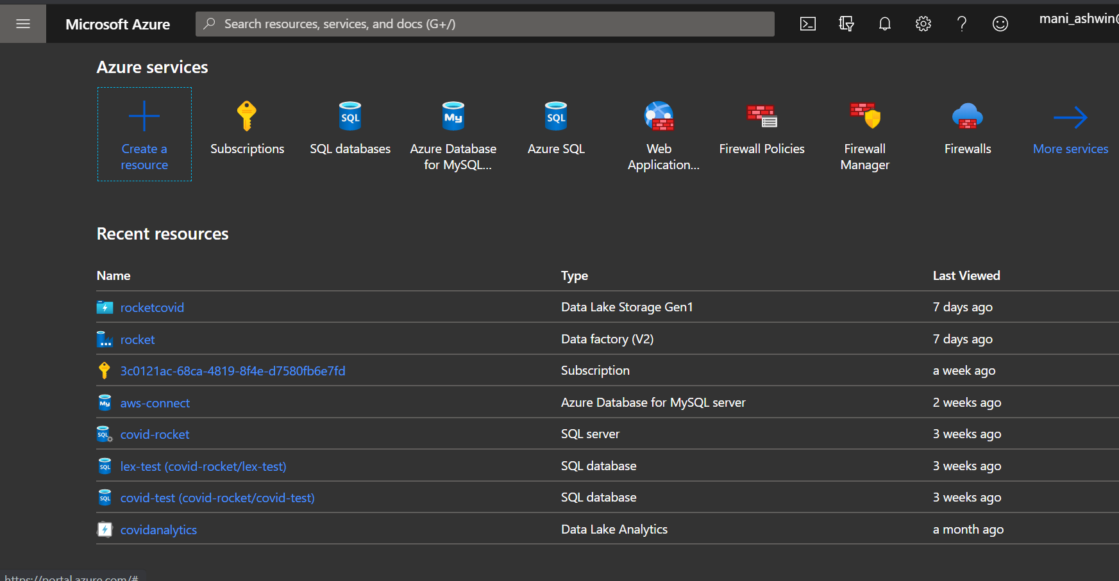
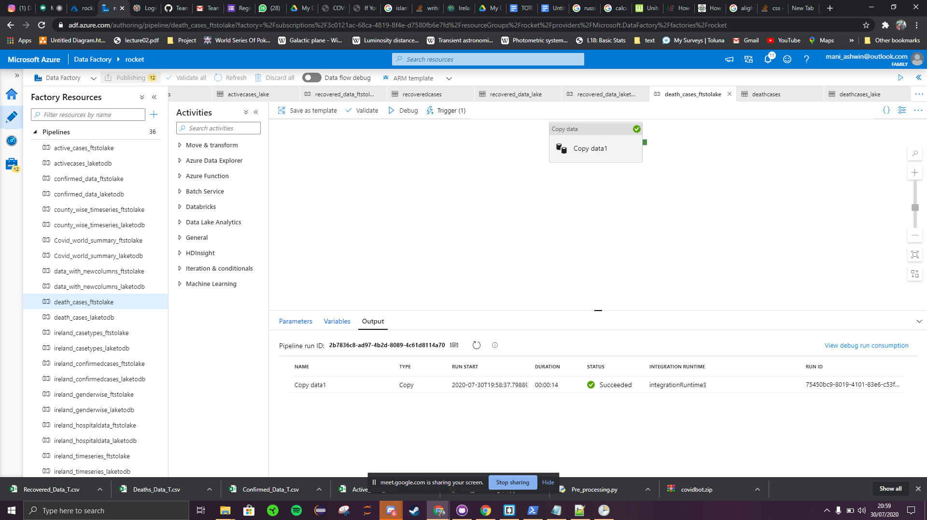
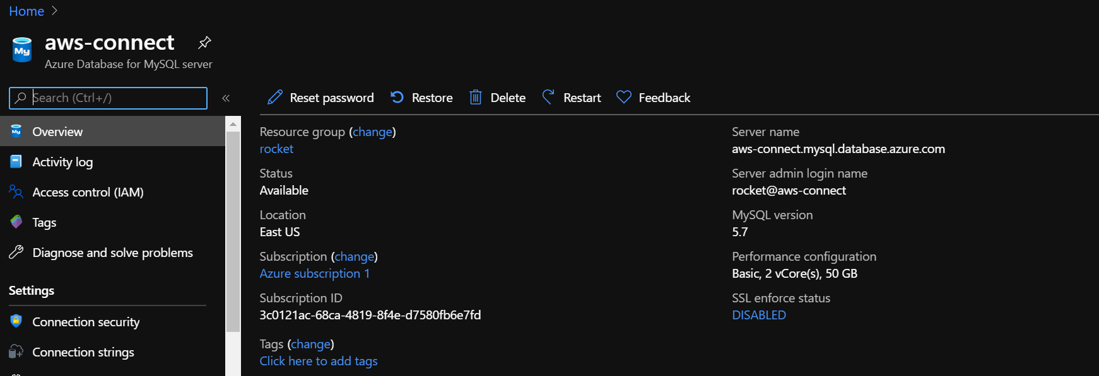
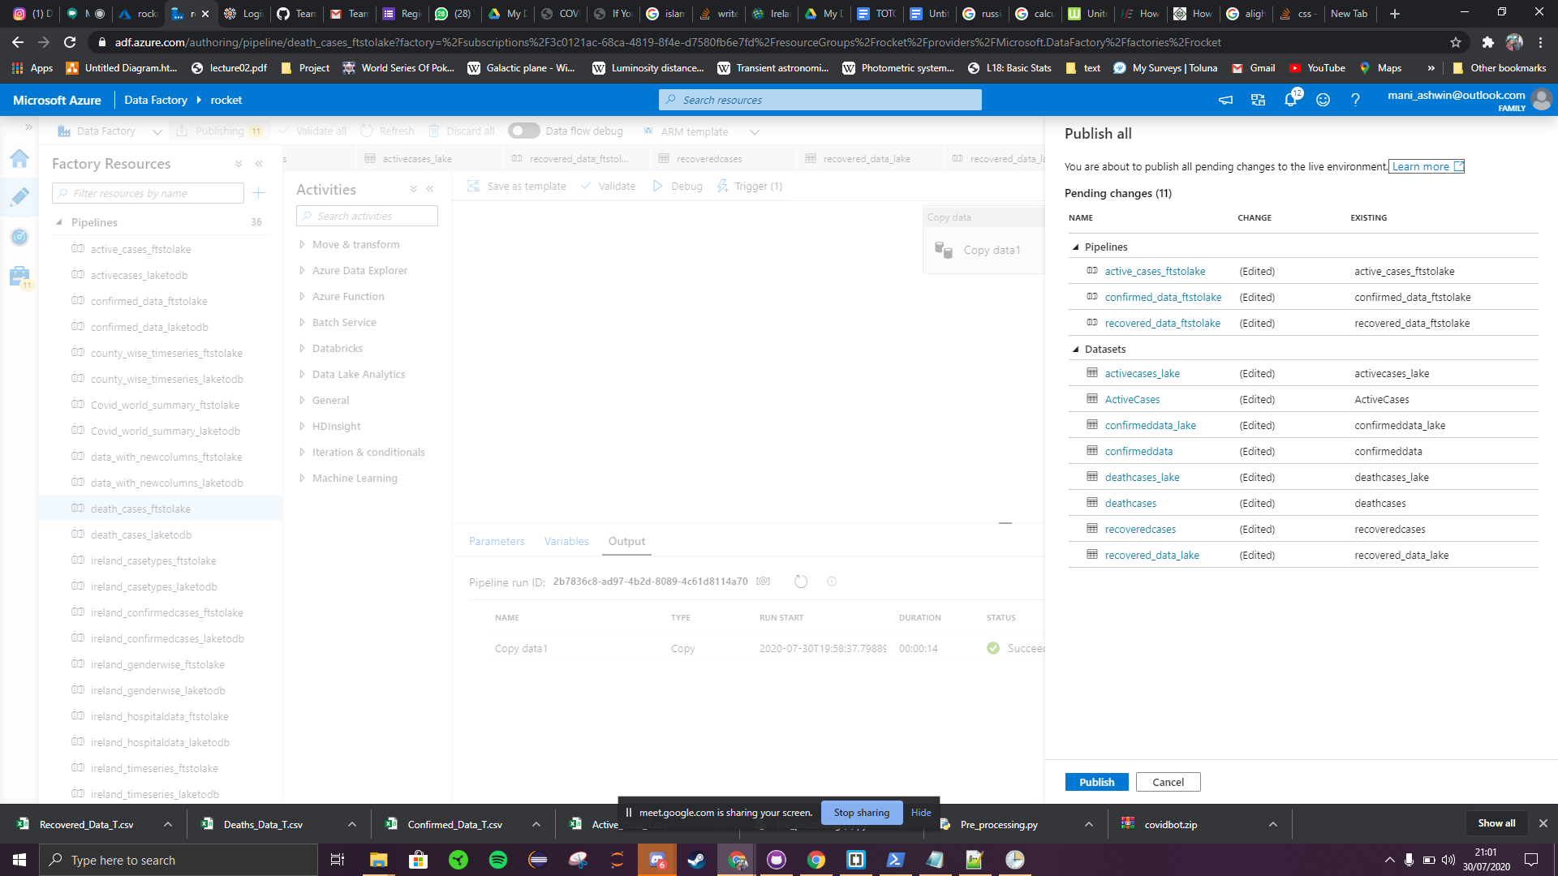
Cloud
Data ingestion and transfer
Deploying Resources
Data is stored in Data Lake and an instance of MySQL server
Automation
Compare cloud platforms and deploy required resources
Pipelines and triggers are created for automated ETL process

Slide 14
The Team
Data
Chatbot
Cloud
Web Dev
Apurva Deore
Vishal Padma
Sumit Kumar
Nripendra Singh
Ashwin Manikandan
Minaz Shaikh
Aditya Krishnan
Data Collection and analysis
Scripts for Data processing
Deployment of Lex API
Intents for user query responses
Setting up storage and DB servers
Pipelines and triggers for E2E automation
UI design and layout
Integration of front-end and back-end

Slide 15
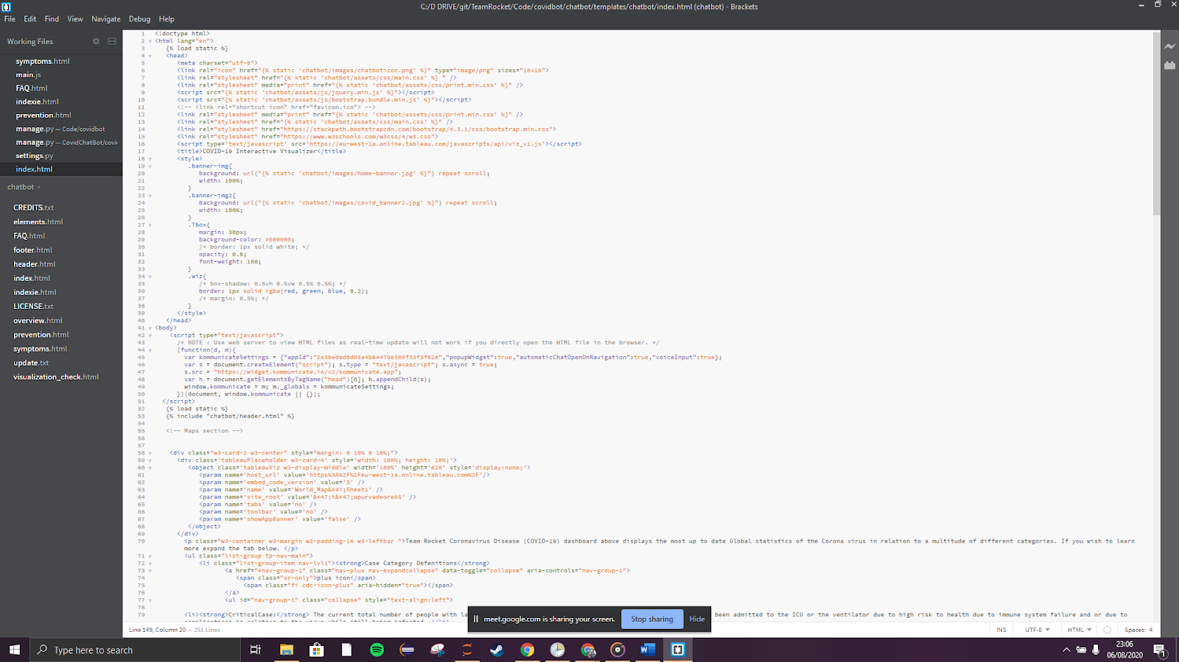
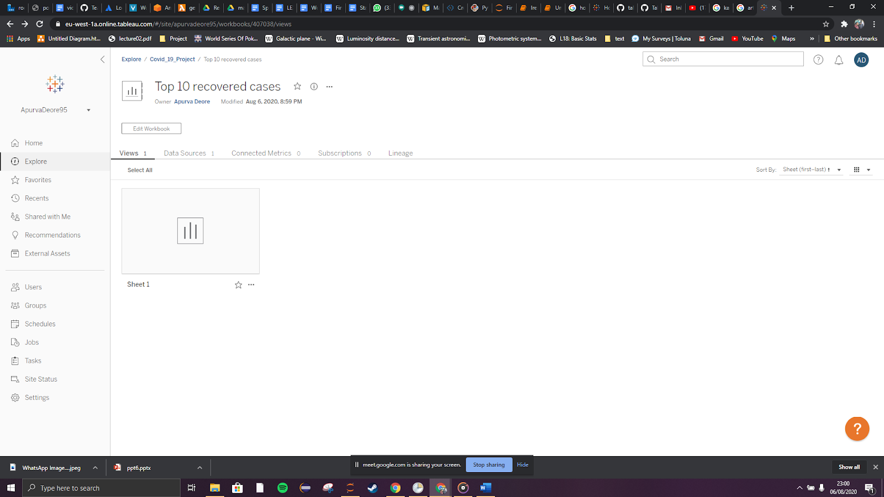
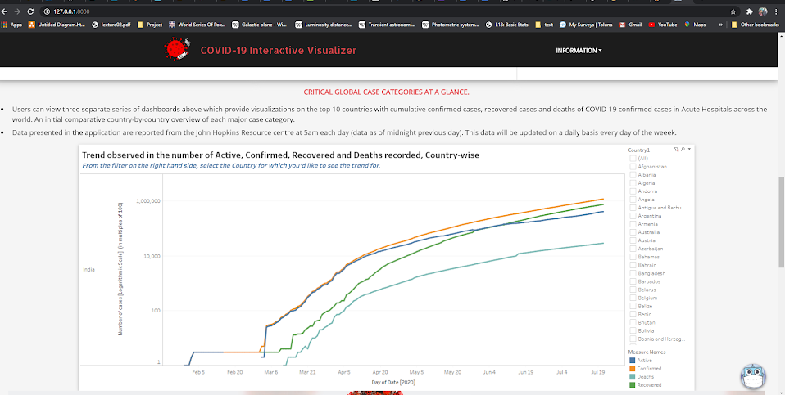
Web Dev
Website design and conceptualization
Data visualizations
Created user interactable platform by combining data and their visualizations
Hosting
Created visualizations and graphs using Tableau
The website is hosted on EC2 instance of AWS

Slide 16
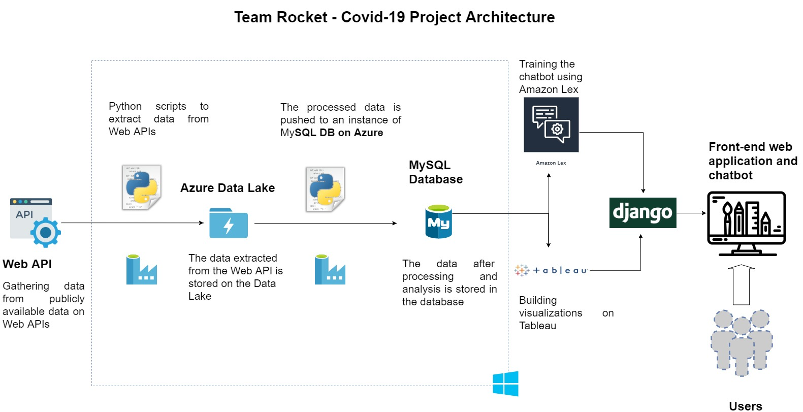
Putting It All Together

Slide 17





Our Journey
Version 1
Final Demo and Report
Extract data from API
Chatbot answering basic queries
Finalize visualizations
Test cloud framework
Version 3
Performing user-based testing
Refining scope of chatbot to Ireland
Hosting website on AWS
Automating ETL process
Version 2
Fine –tuning the data samples
Chatbot interacting with users and answer customized queries
World Map and index page functional on the website

Slide 18
Our Reflections…
Positives
Negatives
Standardized framework for data collection and processing
Exploration of different cloud platforms and resources
Team communication was top quality
Jira and Git encouraged accountability
Learnt to pivot and better prepare for contingencies
Given the initial vision, the chatbot is not flexible enough
Underestimated the time required to train the chatbot
Further inspection and utilization of other visualization tools could have been done
Team would have further benefitted if each worked on multiple aspects of the project

Slide 19

Thank You
TEAM

